Slide 1
Venus Medical Research
By Group 4 (Rocket)

Slide 2
Order
Task 3 first (checking data)
These Individual checks could easily be developed and tested individually
Task 1 next (downloading data)
In order to allow a UI/GUI to be added we thought it would make sense to first have a system that could download the files
Task 2 after (UI/GUI)
We could then use our knowledge of what we had built for downloading the data to build a UI that satisfied our needs
Merging
After all these systems were built we merged them all together to build the final product

Slide 3
Standards
Project standards:
All checks return True if they detect a problem and False if they don't (True = Bad, False = Good)
All filenames are in snake case
The names of the files carrying out checks all end with "check"
All checks take the file as input, which has to be named explicity (file_path = "......")

Slide 4
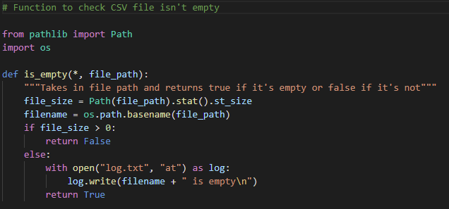
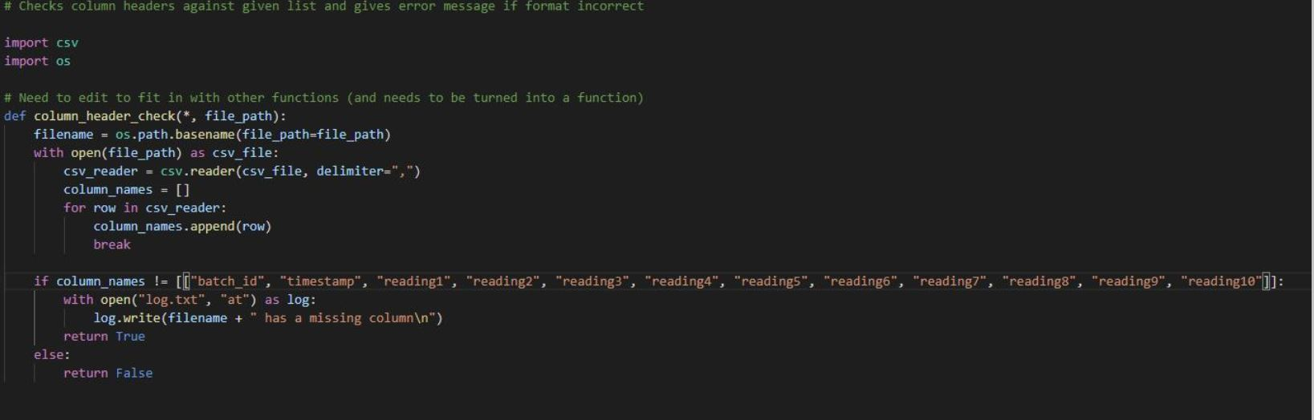
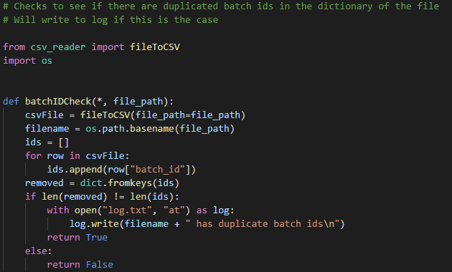
Task 3 (checking data)
Checks:
column_check
date_in_range_check
batchid_check
column_headers_check
filename_check
is_duplicate_file_check
is_empty_file_check

Slide 5
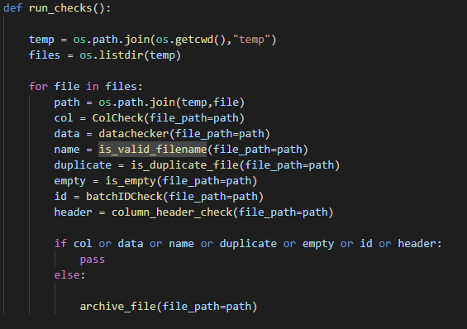
check_runner

Slide 6
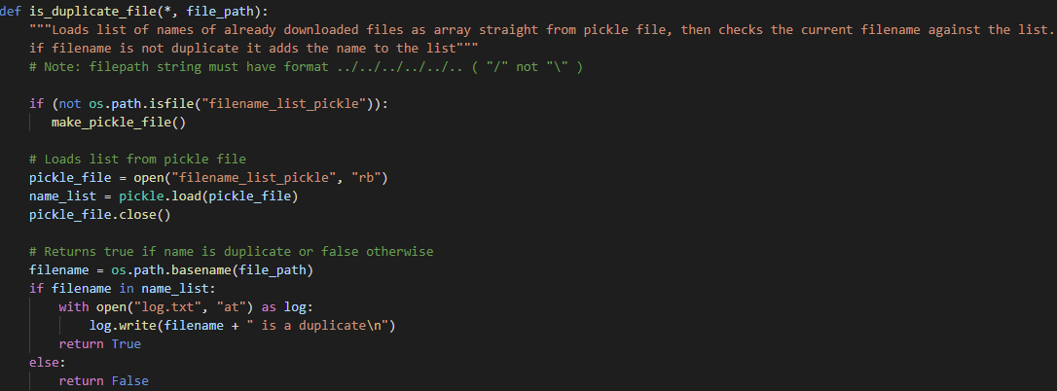
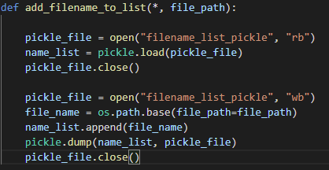

Task 3 and Task 1 – Pickle

Slide 7
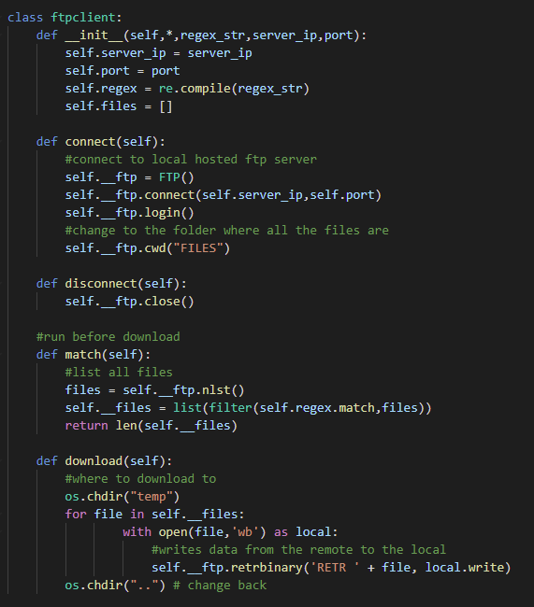

Task 1 (downloading data)

Slide 8
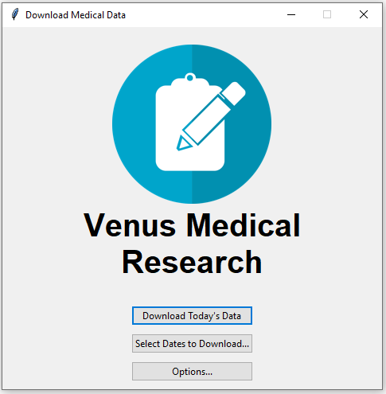
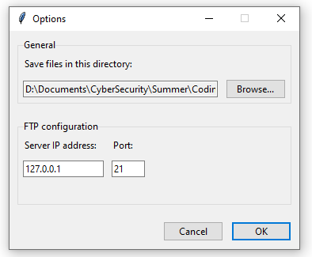
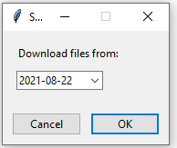
Task 2 (UI/GUI)

Slide 9
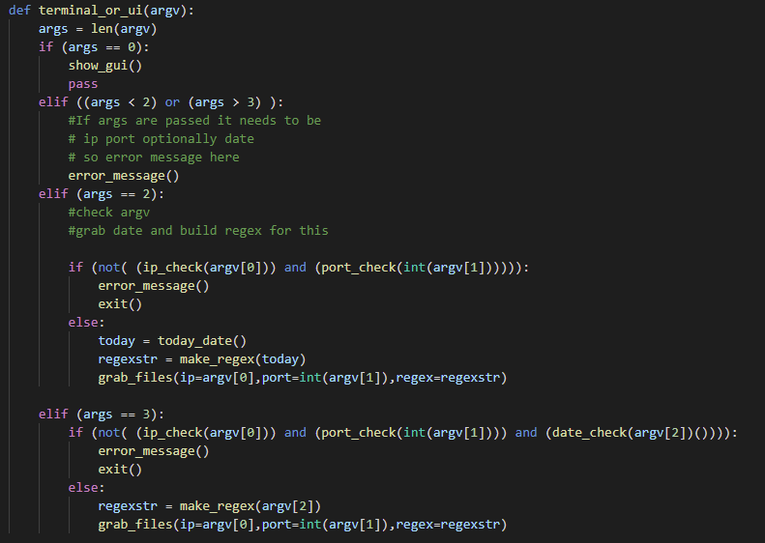
Merging

Slide 10
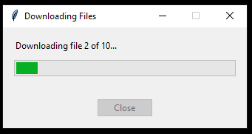
Future
Date Ranges
We have a download window, but currently no way of monitoring file download speed

